Slide 1
Dynamic Modeling

Slide 2
Objectives
To review interaction diagrams
  Sequence diagrams
  Collaboration diagrams
To review statecharts
  State
  Event
  Condition
  Action

Slide 3
Scenarios
A scenario is an instance of a use case - It is one path through the flow of events for the use case.
Scenarios are used to describe how use cases are realized as interactions among societies of objects.

Slide 4
Dynamic Modeling
Determine how objects interact with each other to support use case
  Start with external event from actor
  Determine objects needed to support use case
  Determine sequence of internal events following external event
  Depict on an interaction diagram

Slide 5
Interaction Diagrams
Two types of interaction diagrams
  Sequence diagrams
    Emphasizes the time ordering of messages.
  Collaboration diagrams
    Emphasizes the structural organization of the objects that send and receive messages.

Slide 6
Message Sequence Numbering
Whole number for external event
  1, 2, 3, etc.
Decimal number for subsequent internal events
  1.1, 1.2, etc.
Lowercase letter for concurrent event sequences
  3, 3a, etc.
Uppercase letter for alternative sequences
  1.4[Normal], 1.4A[Error]

Slide 7
Collaboration Diagram for
Validate PIN Use Case:
ATM Client

Slide 8
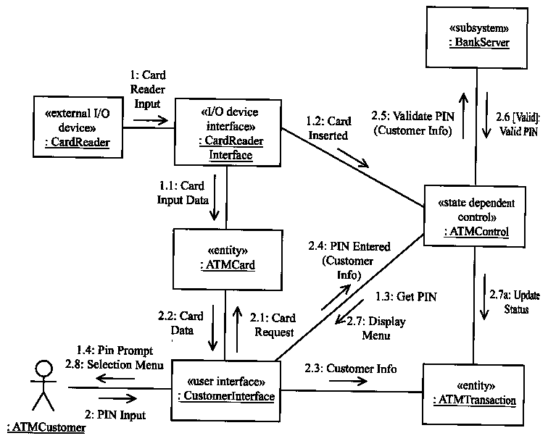

Slide 9
Sequence Diagram for
Validate PIN Use Case:
ATM Client

Slide 10
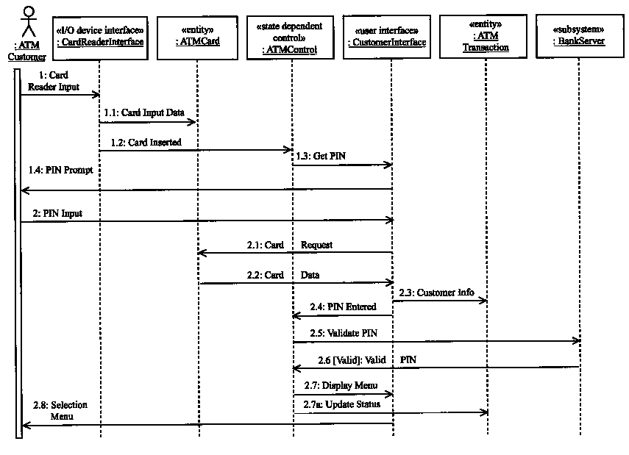

Slide 11
Collaboration Diagram for
Validate PIN Use Case:
Bank Server

Slide 12
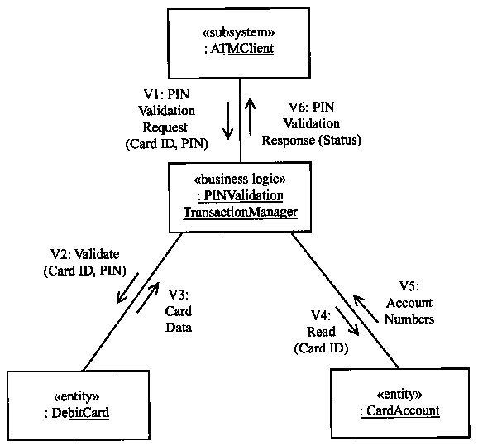

Slide 13
Collaboration Diagram for
Withdraw Funds Use Case:
ATM Client

Slide 14
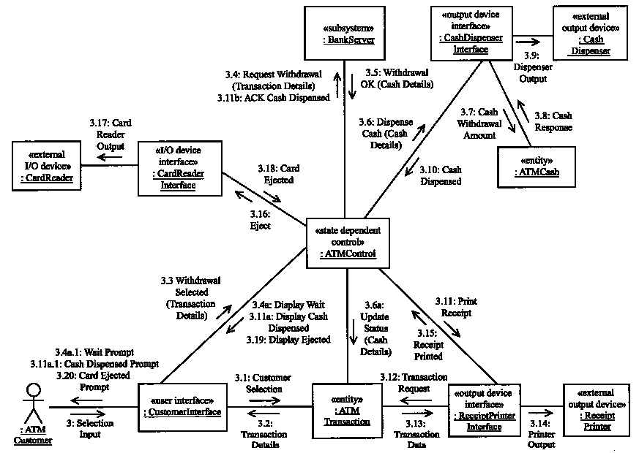

Slide 15
Collaboration Diagram for
Withdraw Funds Use Case:
Bank Server

Slide 16
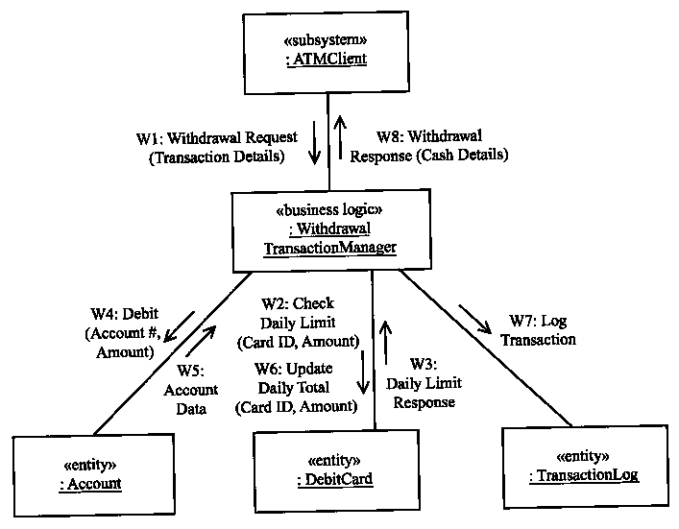

Slide 17
Statecharts
A statechart diagram models the state of a single object, the events or messages that cause a transition from one state to another, and the actions that results from a state change.
  States represented as rounded boxes
  Transitions represented as arcs
Not for every class in the system – only for state dependent control classes.

Slide 18
Statecharts (Cont’d)
State
  A recognizable situation
  Exists over an interval of time
  Represents an interval between successive events
Event
  Causes change of state
  Happens at a point on time
  Has no duration
Condition
  Optional Boolean expression
  When event occurs, condition must be true for transition to occur

Slide 19
Statecharts (Cont’d)
Action
  Executed as a result of state transition
  Is optional
  Exit and Entry Actions
    Entry action – executed on entry into state
    Exit action – executed on exit from state
State transition label
  Event [condition] / action(s)

Slide 20
Statechart for ATM Control

Slide 21
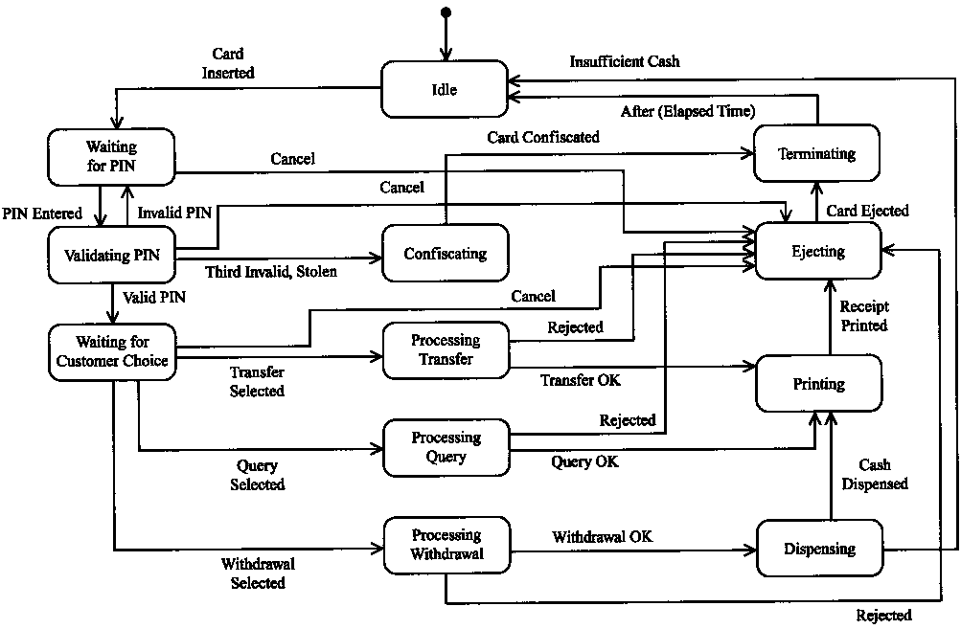

Slide 22
Top-level Statechart for
ATM Control

Slide 23
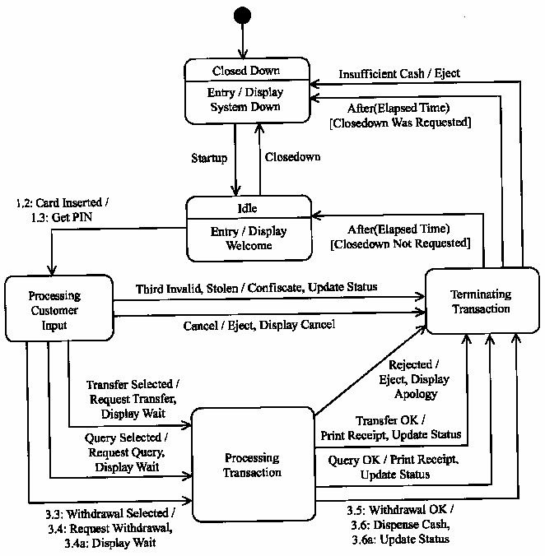

Slide 24
Statechart for ATM Control:
Processing Customer Input Superstate

Slide 25
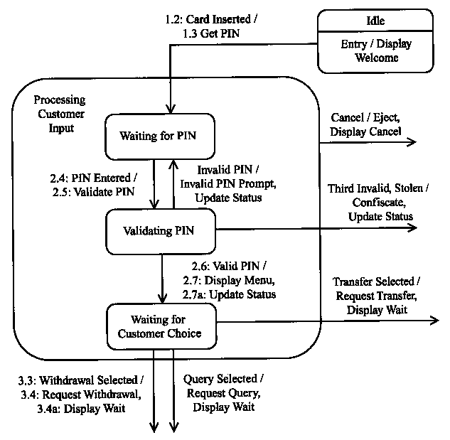

Slide 26
Statechart for ATM Control:
Processing Transaction Superstate

Slide 27
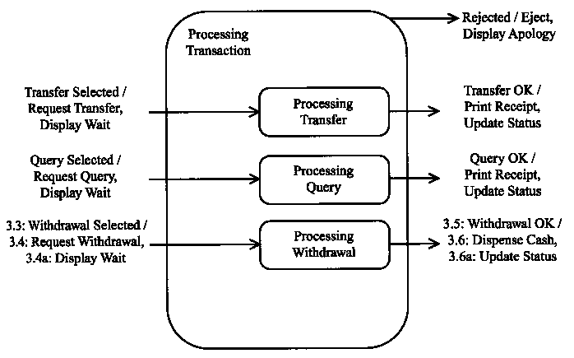

Slide 28
Statechart for ATM Control:
Terminating Transaction Superstate

Slide 29
